Slide 1
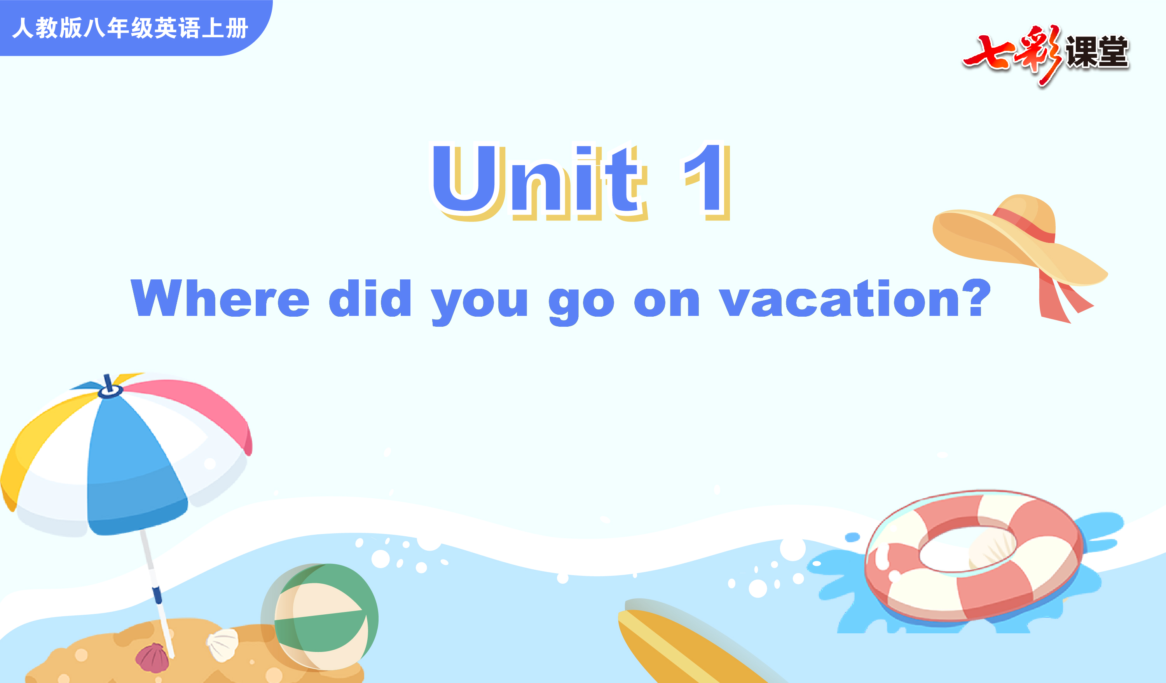
Section B 3a-Self Check

Slide 2
Objectives
To learn to talk about your holiday.
To learn to write a travel diary.
To use the Indefinite Pronouns and the verbs corectly.

Slide 3

日 记
日记是中考各省市常考的题型。
记叙自己一天生活中所看到、遇到、想到和做过的事情，特别是那些具有教育意义或值得回忆、查阅或参考的事情，也可以用来抒发自己当天对某些事件的感受，以及对将来的打算等。

Slide 4
1.格式：英文日记和中文日记的写法大致相同。一般是第一行写上日期、星期、天气状况。日期通常顶格写，后面是星期，天气状况写在右上角。表示天气情况的词一般用形容词，如：fine, cold, rainy, windy, cloudy, sunny, snowy， foggy等。正文部分另起一行。
2.人称：日记要用第一人称写。

Slide 5
3.时态：写日记的时间一般是在下午或晚上，有时也有在第二天补记的。所记叙的事情通常发生在过去，所以常用一般过去时态。但如果要记叙天气、描写景色、展望未来、议论某事或对话引语等，可以使用一般现在时或一般将来时，以生动再现当时的情景。

Slide 6
4.日记的写作顺序：日记一般要按照时间顺序或事情的经过来写。语言要清楚、自然，内容要连贯、完整。

Slide 7

Memory Game
记忆游戏
Did they ...?

Slide 8
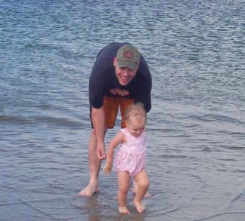


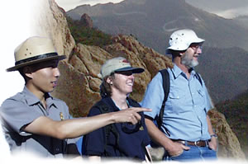
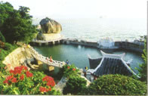


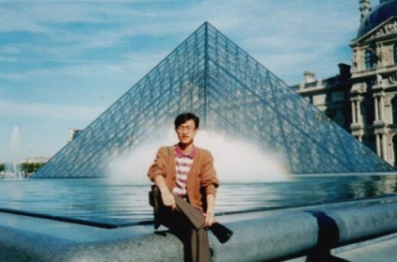

Slide 9
f
b
a
went to the beach
stayed at home
went shopping
d
e
c
went to New York City
went to the mountains
went to a park
h
i
g
went to summer camp
visited museums
went fishing

Slide 10
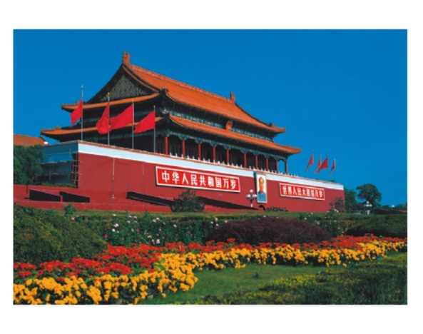
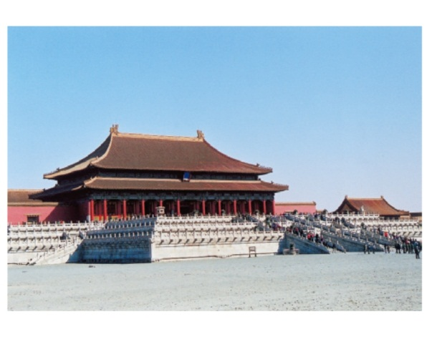
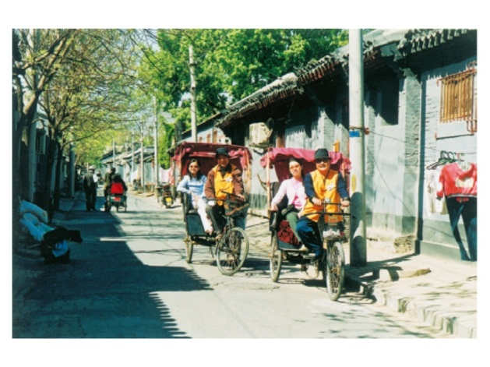
3a
Complete the diary entry about a trip to one of these places. Use the words and phrases in the box to help you.

Slide 11
hot and sunny tired
Beijing duck delicious
take some photos beautiful
buy something special interesting
learn something important August
Wednesday, _______ 20th
Today the weather was _____________. I went to ______________. It was ________. We _______________. I liked this place because ____________________________.
August
hot and sunny
a Beijing hutong
beautiful
took some photos
I learned something important

Slide 12
hot and sunny tired
Beijing duck delicious
take some photos beautiful
buy something special interesting
learn something important August
For dinner we had ____________. It was ________.
In the evening, I felt really ______.
Beijing duck
delicious
tired

Slide 13
3b
Answer the questions to make notes about a vacation you took.
Where did you go?
2. Did you go with anyone?
3. How was the weather?
4. What did you do every day?
5. What food did you eat?
6. What did you like best?
7. Did you dislike anything?
8. How did you feel about the trip?

Slide 14
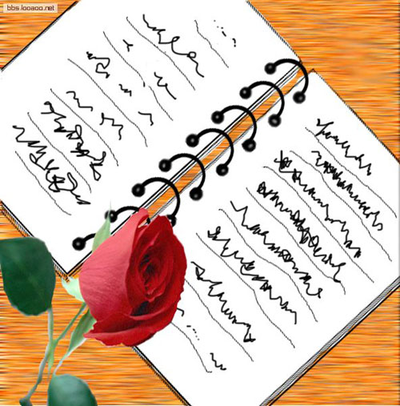
Write a travel diary like Jane’s on page 5. Use your notes in 3b.
3c
_____________________
_____________________
_____________________
_____________________
_____________________

Slide 15
Thursday, August 1st
Today I went to the Palace Museum. It was cool. Then I
went to visit the Great Wall. How great it is! I took many
photos there. In the afternoon, I went to Tian’anmen Square.
The square is very large. Today is Chinese Army Day. So
there were many people there and it was very crowded. We
had great fun playing there! At last, we traveled around a
Beijing hutong on three-wheelers. The Chinese people are
very friendly. I felt very happy today, but I was really tired.

Slide 16
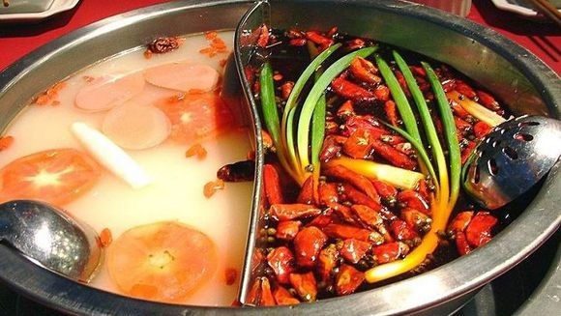
Sample writing:
Sunday, May 25th
I arrived in Chengdu
this morning with my
parents.
It was sunny and warm,
so we decided to go for a
walk near our hotel. We saw many pretty buildings and lots of good restaurants. For lunch, we had hot pot. It was very spicy but delicious.

Slide 17
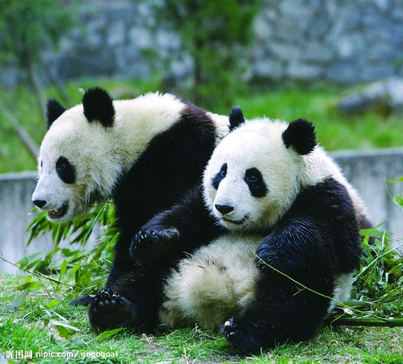
I love Sichuan food! In the afternoon, we went to see pandas in the zoo. Pandas are my favorite animals because they’re so cute. I was happy to know people are trying their best to save them. In the evening,
we went shopping along
Chunxi Road and bought
many things. I felt tired
but happy.

Slide 18
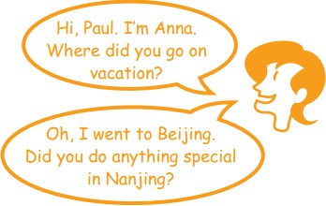
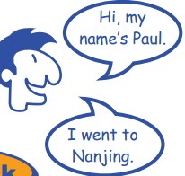
Imagine you are all foreigners on vacation in China. You meet each other at the airport on your way home. Talk about what you did on your vacation.
4

Slide 19
Make a survey and complete the chart.
Make questions about vacation.
Ask the questions yourself.
Ask your classmates the questions.
Discuss with your classmates the best place
for a vacation.
5. Write a report on students’ vacations.

Slide 20

Here is an example:
Questionnaire Name: Mary age: 12 sex: female date: May 1
Place | Summer Palace | Beijing Stadium
Activities | go boating | go roll-skating
Food | fast food | noodles
Weather | sunny | cool
souvenirs | sun glasses | a cap

Slide 21
Self Check
1 Complete the conversations with the correct words
in the box.
anything everything nothing anyone everyone no one
A: Did go on vacation with you last month?
B: Yes, my family went to the countryside with me.
2. A: Did your family go to the beach with you last weekend?
anyone

Slide 22
No one
B: No. _______ from my family went, but my friend went
with me.
3. A: I didn’t bring back anything from Malaysia.
B: ________at all? Why not?
4. A: Did you buy _________ in the shopping center?
B: No, I didn’t.___________was very expensive.
5. A: How was the volleyball game yesterday?
B: Great! __________had a fun time!
Nothing
anything
Everything
Everyone

Slide 23
2. Complete the passage with the correct forms of the verbs in brackets.
Last August, our class ______(do) something very special on our school trip. We _______(go) to Mount Tai. We _______ (start) our trip at 12:00 at night. Everyone in our class _______(take) a bag with some food and water.
did
went
started
took

Slide 24
After three hours, someone looked at the map and _______ (find) out we _______ (be, not) anywhere near the top. My legs _______(be) so tired that I wanted to stop. My classmates_______(tell) me to keep going, so I __________ (go) on.
found
weren’t
were
told
went

Slide 25
At 5:00 a.m., we got to the top! Everyone __________ (jump) up and down in excitement. Twenty minutes later, the sun _______ (start) to come up. It was so beautiful that we _______ (forget) about the last five hours!
jumped
started
forgot

Slide 26
Exercises
I. 填空。
sunny
1. The weather was _______ (晴朗) last week.
2. The good news made us _______ (感到) very happy.
3. I found a girl ________ (哭) in the corner on my way
home yesterday.
4. We had __________ (美味的) Sichuan food for dinner
today.
5. Where did you go on your _________ (假期)?
feel
crying
delicious
vacation

Slide 27
6. Her sweater was ______________. (昂贵的)
7. She _______ (学习) for exams last week.
8. Cathy _________(听) to popular music last night.
9. Jim ______ (去) to the movies with his friends last
weekend.
10. She ______ (看) an interesting talk show yesterday.
expensive
studied
listened
went
saw

Slide 28
II. 补全对话。
A: Hi, Lucy. How _____ you?
B: I _____ fine, thank you. How _____ your vacation?
A: It _____ interesting.
B: Really? Where ______ you go on vacation?
A: I _____ to the mountains.
B: _____ you see the monkey?
A: Yes, I did.
are
am
was
was
did
went
Did

Slide 29
III. 用括号内所给单词的适当形式填空。
1. I _______ _____(not visit) the Great Wall last summer.
I _______ (go) to Qingdao on vacation.
2. — How _____ (be) the beaches there?
— Beautiful.
didn’t visit
went
were

Slide 30
go
3. — ____ Nancy ____ (go) to New York city last weekend?
— Yes. She_____ (go) there with her parents.
4. Mary ________ (stay) at home and _______ (study) for
the exam last Sunday.
5. — What ______you ______(buy) in Beijing?
— I bought nothing.
Did
went
stayed
studied
did
buy

Slide 31
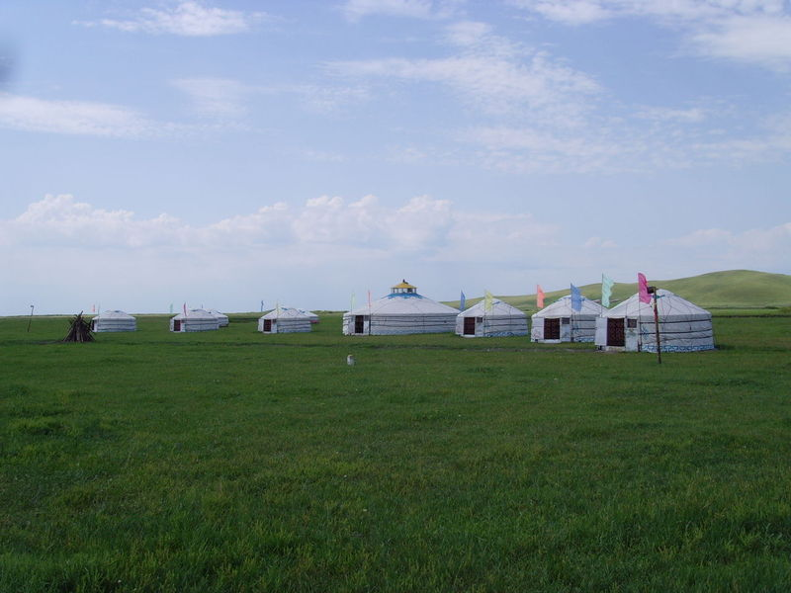
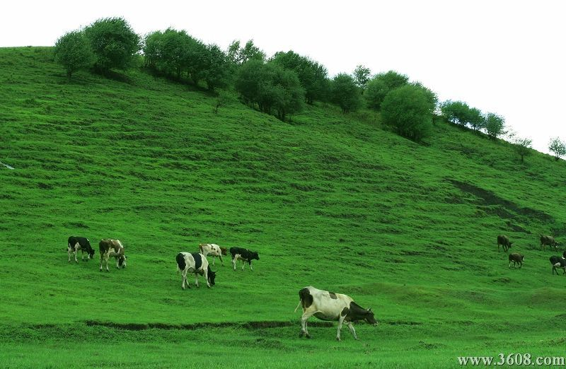
Homework
Imagine you are on vacation in the
prairie(草原). Write a travel diary.

Slide 32

七彩课堂 伴你成长

